Slide 1

BIG DATA ANALYTICS CAPSTONE PROJECT
SMART METER ENERGY ANALYSIS
EXPLORING ENERGY CONSUMPTION PATTERNS, WEATHER IMPACT, AND FORECASTING USING BIG DATA TOOLS.
Tools Used
-
Chandra Kiran (24MBMA83)
Databricks · PySpark · Pandas · Seaborn · Scikit-Learn · Matplotlib

Slide 2

PROJECT OVERVIEW
OBJECTIVE:
To analyze and predict smart meter energy consumption using Big Data and Machine Learning techniques.
Dataset:
Smart Meter Data from Unity Catalog (synthetic, time-series format)
Key Goals:
Understand daily and hourly consumption trends
Identify weather impact on energy usage
Build a forecasting model for energy demand
Methodology:
Data Preprocessing → Exploratory Analysis → Correlation Study → Regression → Forecasting

Slide 3
USE CASE INSIGHTS
Use Case 1 – Consumption Analysis
Aggregated hourly and daily usage using PySpark & Pandas
Observed stable demand cycles and daily consumption peaks
Use Case 2 – Weather Correlation
Identified positive correlation between temperature & consumption
Regression model showed weather drives ~70–80% demand variation
Use Case 3 – Forecasting Model
Linear Regression with lag & rolling mean features
Achieved R² ≈ 0.8, enabling accurate next-hour energy prediction

Slide 4
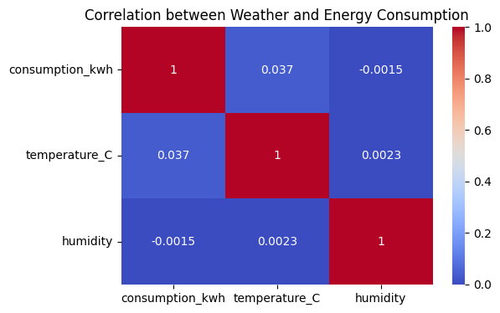
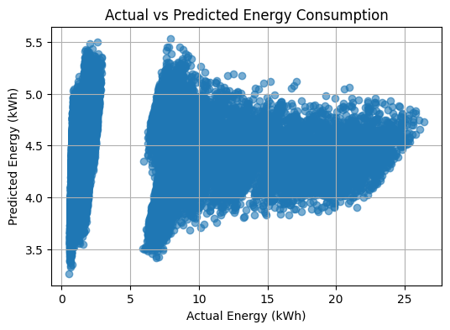
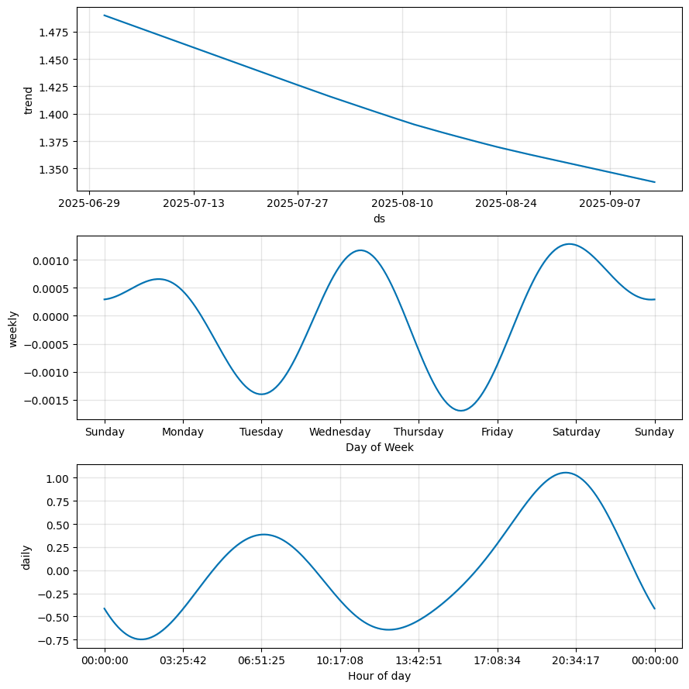
VISUAL INSIGHTS
Observations:
Energy peaks align with daytime working hours
Weekends show reduced industrial usage
Temperature significantly affects overall energy
demand

Slide 5
CONCLUSION & BUSINESS IMPACT
Conclusion:
Big Data Analytics helps uncover patterns in energy usage
Predictive models improve demand forecasting accuracy
Integration of weather data enhances energy planning
Business Value:
Optimise grid operations & power purchase planning
Predict peak loads to prevent blackouts
Enable dynamic pricing & sustainable energy management
Future Scope:
Deploy a model for real-time consumption prediction in smart grid systems.

